Slide 1
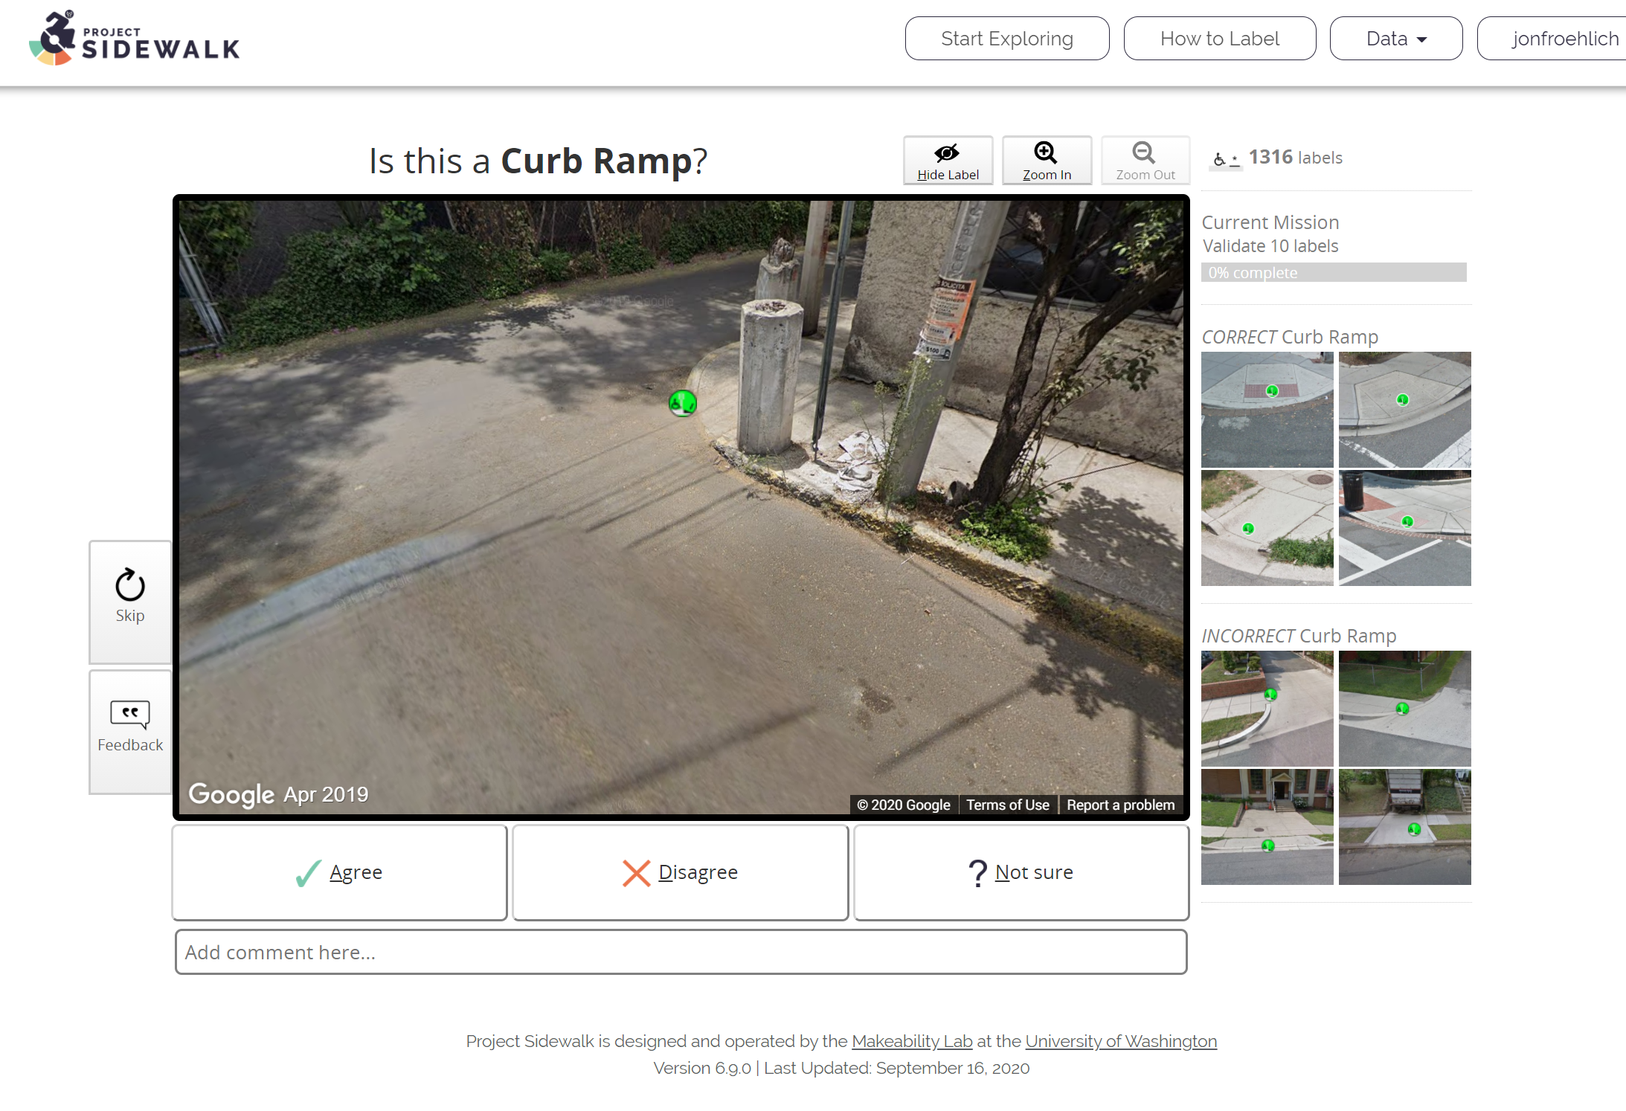
You validate people’s labels
X, Y and Z
Typical validation rates are X, Y, and Z

Slide 2
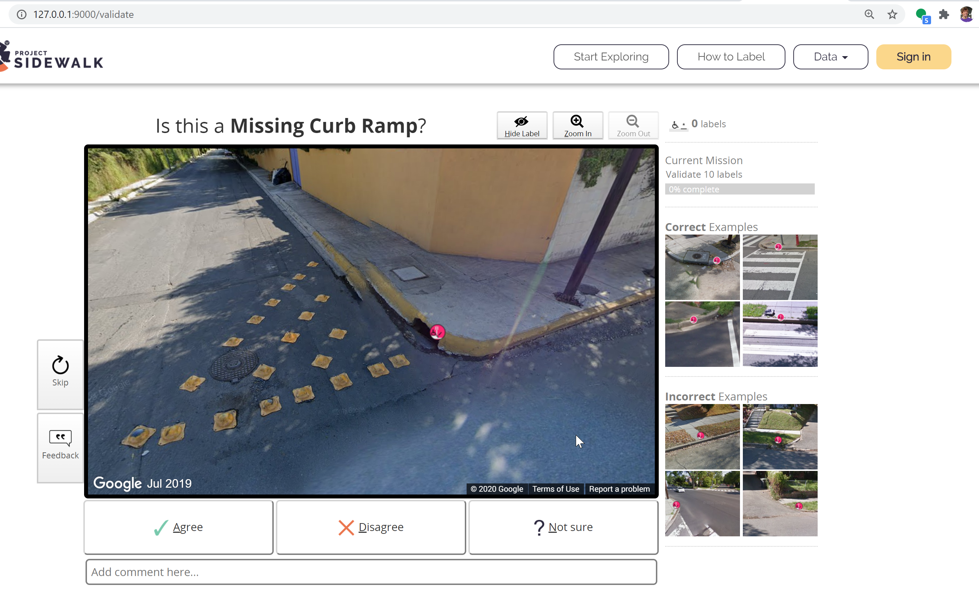

Slide 4
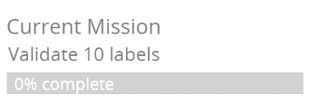
 | Agree | Disagree | Unsure
Your counts | 333 | 125 | 50
Your % | 75% | 15% | 5%
Others’ % | 80% | 5% | 15%

Slide 5
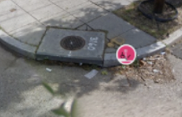
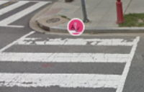
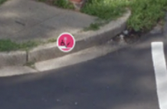
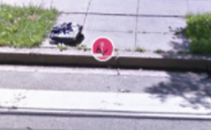
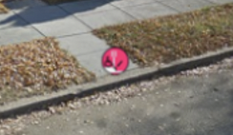
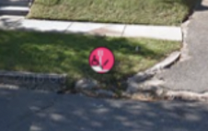
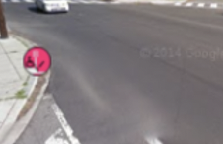
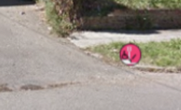
All Labels
Count:
You agree:
Others agree:
498 validations
71%
83%
Missing Curb Ramps
Count:
You agree:
Others agree:
98 validations
75%
85%
Correct Labels
Incorrect Labels

Slide 6
All Labels
498 validations
You agree: 71%
Others’ agree: 83%
Missing Curb Ramps
98 validations
You agree: 75%
Others’ agree: 85%
Correct Labels
Incorrect Labels

Slide 7

All Labels
498 validations
You agree: 71%
Others’ agree: 83%
Your Rank
4th
Missing Curb Ramps
98 validations
You agree: 75%
Others’ agree: 85%
Correct Labels
Incorrect Labels

Slide 8

All Labels
498 validations
You agree: 71%
Others’ agree: 83%
Achievements
Validations Badges
Your Rank
4th
100
500
1K
10K
Correct Labels
Incorrect Labels

Slide 9


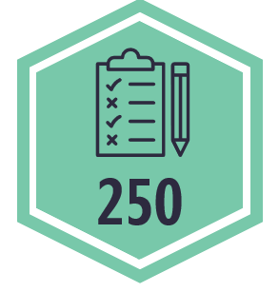
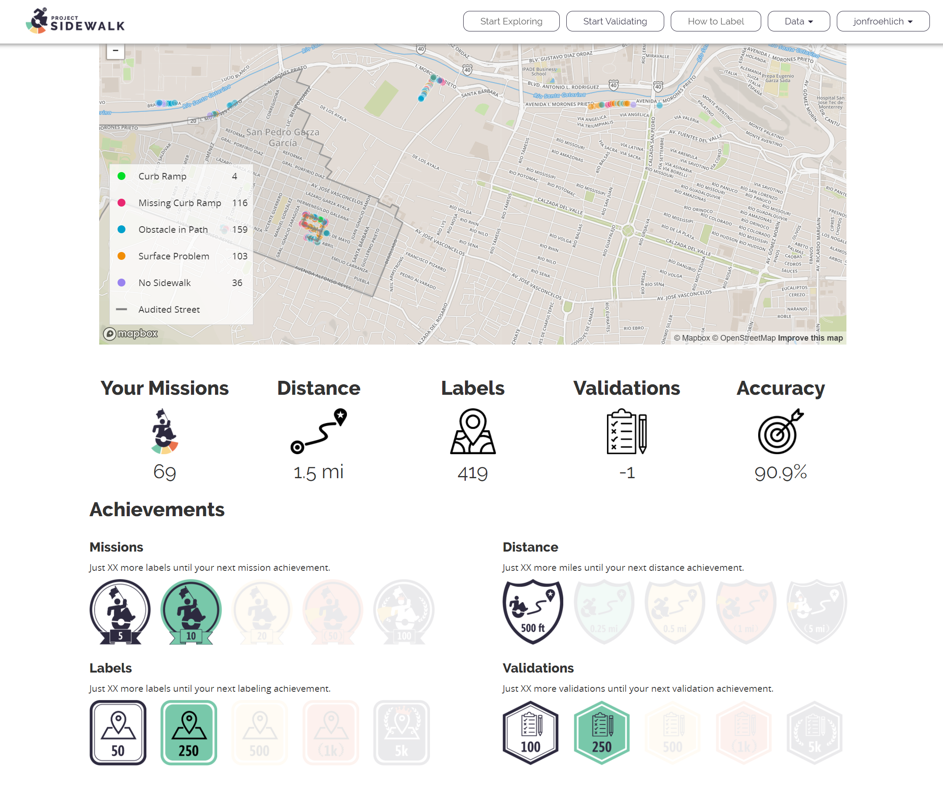
Current Mission
Validate 10 labels
50%
Achievements
Validations
21%
Missions
67%
Correct Labels

Slide 10
Current Mission
Validate 10 labels
50%
Achievements
Validations
21%
Missions
21%
Correct Labels

Slide 11



Current Mission
Validate 10 labels
50%
Badge Progress
Validations: 122/200
21%
Missions: 12/20
9%
Rank
Missions
Validations
8th
3rd
Correct Labels

Slide 12
sidebar width
Current Mission
Validate 10 labels
50%
122
545
Achievements
Validations: 122/200
21%
Missions: 12/20
9%
Rank
Missions
Validations
8th
3rd
Correct Labels

Slide 13






sidebar width
Current Mission
Validate 10 labels
50%
Achievements
Validations: 122/200
21%
Missions: 12/20
9%
Missions
Validations
Rank
Badges
3rd
8th
Correct Labels
Rank

Slide 14
sidebar width
Current Mission
Validate 10 labels
50%
Achievements
Validations: 122/200
21%
Missions: 12/20
9%
Missions
10
20
Validations
12
Complete 8 more missions to earn your next mission achievement
3rd
Rank
Badges
Correct Labels
8th
8 more missions
Rank

Slide 15
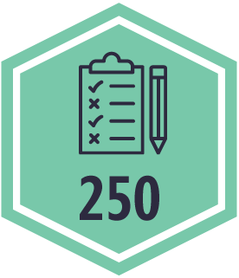
sidebar width
Current Mission
Validate 10 labels
50%
Missions
Validations
9%
Complete 8 more missions to earn your next mission achievement
3rd
Correct Labels
Validations
9%
Complete 8 more missions to earn your next mission achievement
Rank
Badges
8th
8 more missions
Rank

Slide 16
sidebar width
Current Mission
Validate 10 labels
50%
Missions
Validations
9%
Complete 8 more missions to earn your next mission achievement
3rd
Correct Labels
Validations
54%
Complete 8 more missions to earn your next mission achievement
Rank
Badges
8th
8 more missions
Rank

Slide 17
sidebar width
Current Mission
Validate 10 labels
50%
Missions
20
Validations
9%
Complete 8 more missions to earn your next achievement
3rd
Correct Labels
Validations
54%
250
Complete 70 more validations to earn your next achievement
Rank
Badges
8th
8 more missions
Rank

Slide 18






sidebar width
Current Mission
Validate 10 labels
50%
Achievements
Missions
9%
20
Complete 8 more missions to earn your next achievement
Validations
54%
250
Complete 70 more validations to earn your next achievement
Overall Stats
Validations
Missions
Validations
Accuracy
12
144
83%
3rd
Correct Labels
8th
3rd
9th
Rank
Badges
8th
8 more missions
Rank

Slide 19
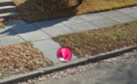
sidebar width
Current Mission
Validate 10 labels
50%
Overall Stats
12
0.8 mi
1,123
83%
102
Achievements
Missions
9%
20
Complete 8 more missions to earn your next achievement
Validations
54%
250
Complete 70 more validations to earn your next achievement
Rank
Validations
Missions
Validations
Accuracy
3rd
8th
3rd
9th
Correct Labels
Examples
Correct label
Incorrect label
Rank
Badges
8th
8 more missions
Rank

Slide 20
Current Mission
Validate 10 labels
50%
Overall Stats
12
0.8 mi
1,123
83%
102
Achievements
Missions
9%
20
Complete 8 more missions to earn your next achievement
Validations
54%
250
Complete 70 more validations to earn your next achievement
Validations
Rank
3rd
Missions
Validations
Accuracy
Correct Labels
8th
3rd
9th
Examples
Correct label
Incorrect label
Rank
Badges
8th
8 more missions
Rank

Slide 21
Current Mission
Validate 10 labels
50%
Overall Stats
12
0.8 mi
1,123
83%
102
Achievements
Missions
Complete 8 more missions to earn your next achievement
Rank
8th
Validations
Complete 70 more validations to earn your next achievement
Validations
3rd
Examples
Correct Labels
Mouseover for more correct and incorrect examples.
Correct label
Incorrect label
Rank
Badges
8th
8 more missions
Rank

Slide 22
Current Mission
Validate 10 labels
50%
Overall Stats
12
0.8 mi
1,123
83%
102
Achievements
Missions
Rank
Badges.
8 more missions until next badge!
5th
Validations
Complete 70 more validations to earn your next achievement
Validations
3rd
Examples
Correct Labels
Mouseover for more correct and incorrect examples.
Correct label
Incorrect label
Rank
Badges
8th
8 more missions
Rank

Slide 23
Current Mission
Validate 10 labels
50%
Overall Stats
12
0.8 mi
1,123
83%
102
Achievements
Missions: 12
Rank
8 more missions until next badge!
5th
Validations: 102
Rank
122 more validations until next badge!
9th
Validations
3rd
Examples
Correct Labels
Mouseover for more correct and incorrect examples.
Correct label
Incorrect label
Rank
Badges
8th
8 more missions
Rank

Slide 24
Current Mission
Validate 10 labels
50%
Your Overall Stats
12
0.8 mi
1,123
83%
102
Achievements
Missions: 12
Rank
8 more missions until next badge!
5th
Validations: 102
Rank
122 more validations until next badge!
9th
Validations
3rd
Correct Labels
Examples
Mouseover for more correct and incorrect examples.
Correct label. A crosswalk but no label.
Incorrect label. Small pathways in front of homes should not be marked as missing curb ramps
Rank
Badges
8th
8 more missions
Rank

Slide 25


Current Mission
Validate 10 labels
50%
Your Overall Stats
Missions
Distance
Labels
Accuracy
Validations
12
0.8 mi
1,123
83%
102
Achievements
Missions: 12
20%
Rank
8 more missions until next badge!
5th
Validations: 152
65%
Rank
98 more validations until next badge!
9th
Validations
3rd
Correct Labels
Examples
Mouseover for more correct and incorrect examples.
Correct label. A crosswalk but no label.
Incorrect label. Small pathways in front of homes should not be marked as missing curb ramps
Rank
Badges
8th
8 more missions
Rank

Slide 26
Current Mission
Validate 10 labels
50%
Overall Stats
12
0.8 mi
1,123
83%
102
Achievements
Missions
Complete 8 more missions to earn your next achievement
Validations
Complete 70 more validations to earn your next achievement
Validations
3rd
Examples
Correct Labels
Mouseover for more correct and incorrect examples.
Correct label
Incorrect label
Rank
Badges
8th
8 more missions
Rank

Slide 27
sidebar width
Current Mission
Validate 10 labels
50%
Your Overall Stats
Missions
Distance
Labels
Accuracy
Validations
12
0.8 mi
1,123
83%
102
8th
5th
3rd
Missions
Validations
9%
8 more missions to your next achievement
3rd
Correct Labels
Validations
9%
122 more validations to your next achievement
Rank
Rank
Badges
8th
8 more missions
Rank

Slide 28
sidebar width
Current Mission
Validate 10 labels
50%
Your Overall Stats
Missions
Distance
Labels
Accuracy
Validations
12
0.8 mi
1,123
83%
102
Achievements
Missions
Distance
Labels
Accuracy
Validations
8th
5th
3rd
Missions
9%
8 more missions to your next achievement
Validations
Validations
9%
122 more validations to your next achievement
3rd
Correct Labels
Rank
Rank
Badges
8th
8 more missions
Rank

Slide 29
sidebar width
Current Mission
Validate 10 labels
50%
Your Overall Stats
Missions
Distance
Labels
Accuracy
Validations
12
0.8 mi
1,123
83%
102
8th
Unranked
Unranked
5th
3rd
Missions
Validations
9%
8 more missions to your next achievement
3rd
Correct Labels
Validations
9%
122 more validations to your next achievement
Rank
Rank
Badges
8th
8 more missions
Rank

Slide 30
sidebar width
Current Mission
Validate 10 labels
50%
Your Overall Stats
Missions
Distance
Labels
Accuracy
Validations
12
0.8 mi
1,123
83%
102
Achievements
Missions: 12
20%
Rank: 5th
8 more missions until next badge!
2 more to 4th place
Validations: 152
65%
Rank: 6+
98 more validations until next badge!
16 more to 5th place
Validations
3rd
Correct Labels
Examples
Mouseover for more correct and incorrect examples.
Correct label. A crosswalk but no label.
Incorrect label. Small pathways in front of homes should not be marked as missing curb ramps
Rank
Badges
8th
8 more missions
Rank

Slide 31
Current Mission
Validate 10 labels
50%
Your Overall Stats
Missions
Distance
Labels
Accuracy
Validations
12
0.8 mi
1,123
83%
102
Achievements
Missions: 12
20%
Rank: 5th
You can do it! Just 8 more missions until next badge!
Validations: 152
65%
Rank: 6+
Complete 12 more validations to move into 5th place!
Help with this mission
Mouseover for more correct and incorrect examples.
Correct label. A crosswalk but no label.
Incorrect label. Small pathways in front of homes should not be marked as missing curb ramps

Slide 32
Current Mission
Validate 10 labels
50%
Your Overall Stats
Missions
Distance
Labels
Accuracy
Validations
12
0.8 mi
1,123
83%
102
Achievements
Missions: 12
20%
Rank: 5th
Validations: 152
65%
Rank: 6+
Help with this mission
Validations
Mouseover for more correct and incorrect examples.
3rd
Correct label. A crosswalk but no label.
Incorrect label. Small pathways in front of homes should not be marked as missing curb ramps
Correct Labels
Rank
Badges
8th
8 more missions
Rank

Slide 34
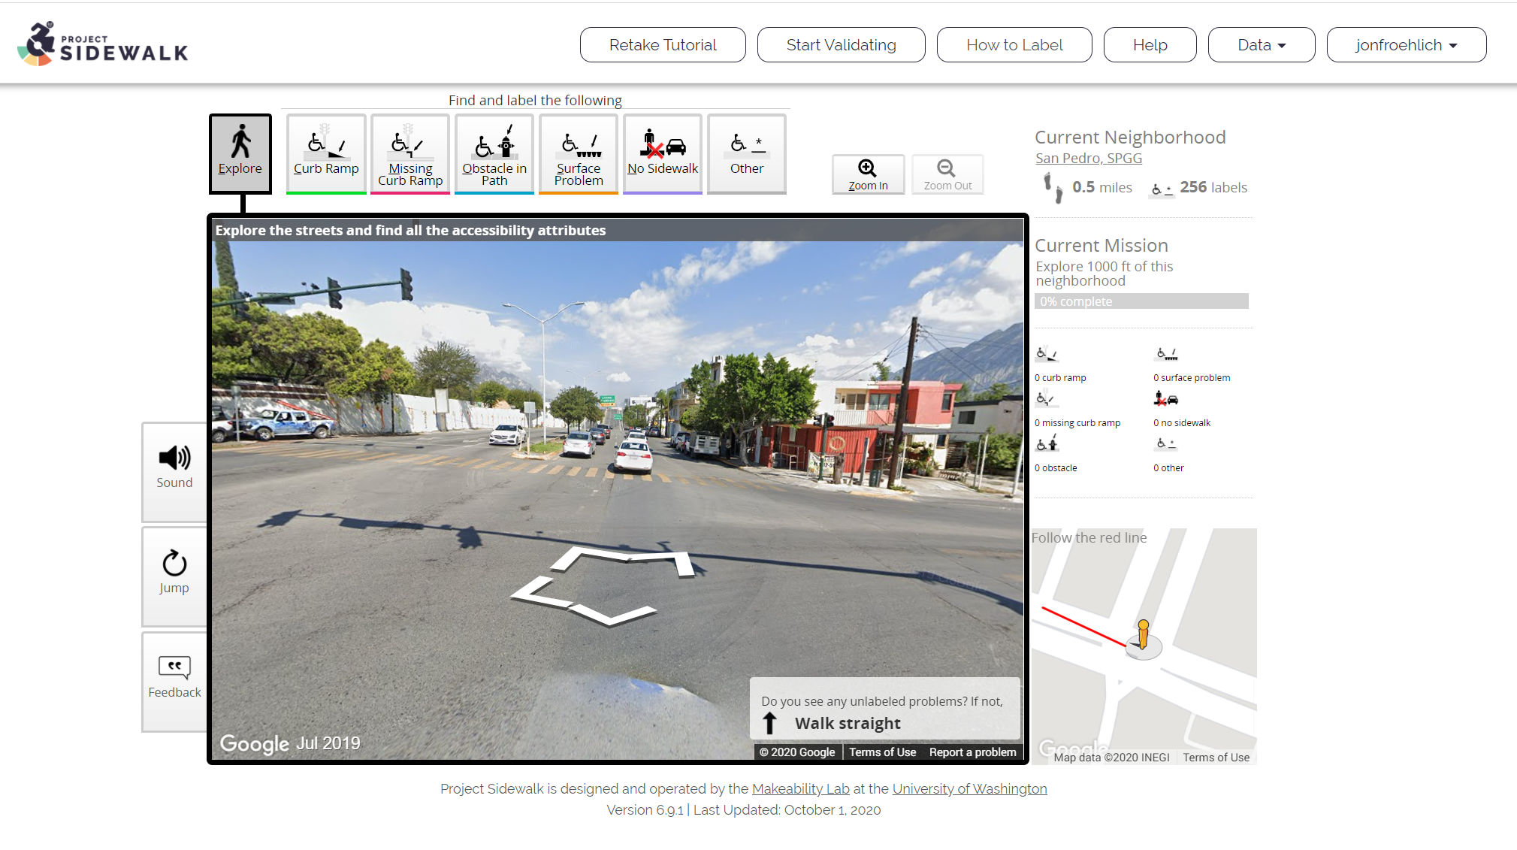

Slide 35

Inspect 1,000 ft in San Pedro, MX
50%
Your Overall Stats
Missions
Distance
Labels
Accuracy
Validations
12
0.8 mi
1,123
83%
102
Achievements
Missions: 12
20%
Rank: 5th
You can do it! Just 8 more missions until next badge!
Validations: 152
65%
Rank: 6+
Complete 12 more validations to move into 5th place!

Slide 36
Inspect 1,000 ft in San Pedro, MX
50%
Your Overall Stats
Missions
Distance
Labels
Accuracy
Validations
12
0.8 mi
1,123
83%
102
Badges
Missions
9%
8 more missions to your next achievement
Labels
9%
122 more validations to your next achievement
Distance
9%
122 more validations to your next achievement

Slide 37
Inspect 1,000 ft in San Pedro, MX
50%
Your Overall Stats
Missions
Distance
Labels
Accuracy
12
0.8 mi
1,123
83%
Badges
Missions
9%
8 more missions to your next achievement
Labels
9%
122 more validations to your next achievement
Distance
9%
122 more validations to your next achievement

Slide 38
Inspect 1,000 ft in San Pedro, MX
50%
Missions
Overall: 12
Neighborhood: 6
9%
Overall: 12
5th
Neighborhood: 6
5th

Slide 39
Inspect 1,000 ft in San Pedro, MX
50%
Missions
Overall: 12
Neighborhood: 6
Rank: 5th
Rank: 3rd
Overall: 12
9%
5th
Neighborhood: 6
5th

Slide 40
Inspect 1,000 ft in San Pedro, MX
50%
Missions
Overall: 12
Neighborhood: 6
(5th)
(3rd)
Overall: 12
9%
5th
Neighborhood: 6
5th

Slide 41
 | Count | Rank
Overall | 1,123 | 8th
Neighborhood | 223 | 4th
Inspect 1,000 ft in San Pedro, MX
50%
Missions
Your Overall Stats
 | Missions
 | Count | Rank
Overall | 1,123 | 8th
Area | 223 | 4th
Missions
Distance
Labels
Accuracy
Validations
12
0.8 mi
1,123
83%
102
Achievements
Overall: 12
Missions: 12
Overall: 12
Area: 6
Rank: 8th / 4th
9%
5th
Labels: 1,123
 | Count | Rank
Overall | 1,123 | 8th
Area | 223 | 4th
Overall: 12
Area: 6
Rank: 8th / 4th
9%
Distance: 0.8 mi
Neighborhood: 6
Overall: 12
Area: 6
Rank: 8th / 4th
9%
5th

Slide 42

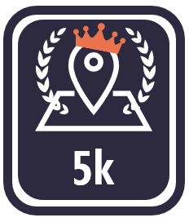

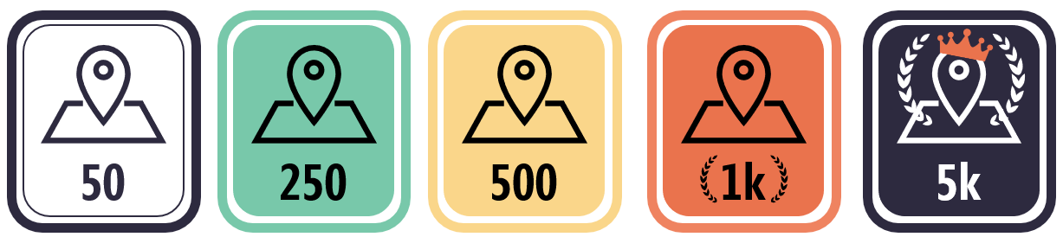

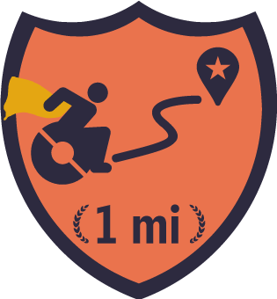
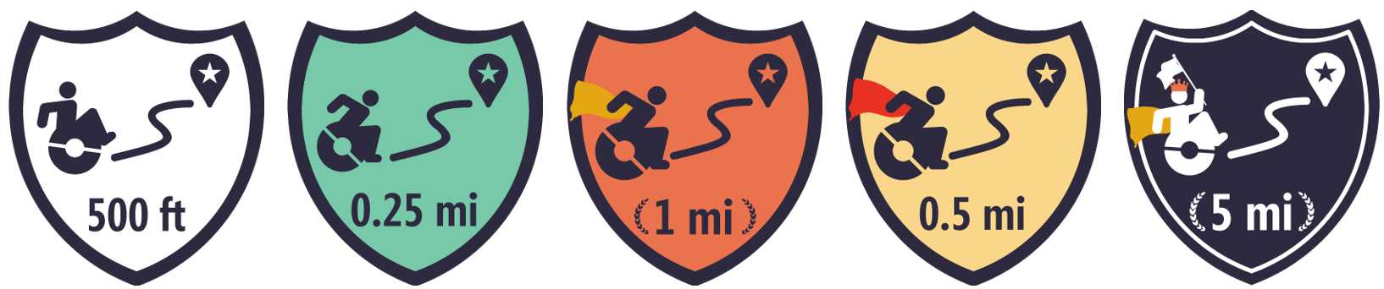

 | Count | Rank
Overall | 1,123 | 8th
Neighborhood | 223 | 4th
Inspect 1,000 ft in San Pedro, MX
50%
Missions
Your Overall Stats
 | Missions
 | Count | Rank
Overall | 1,123 | 8th
Area | 223 | 4th
Missions
Distance
Labels
Accuracy
Validations
12
0.8 mi
1,123
83%
102
Achievements
Overall: 12
Missions: 12
 | Count | Rank
Overall | 1,123 | 8th
Area | 223 | 4th
9%
5th
Labels: 1,123
Overall: 12
Area: 6
Rank: 8th / 4th
3%
Distance: 0.8 mi
Neighborhood: 6
Overall: 0.8 mi
Area: 0.2 mi
Rank: 8th / 4th
73%
5th

Slide 43
 | Count | Rank
Overall | 1,123 | 8th
Neighborhood | 223 | 4th
Inspect 1,000 ft in San Pedro, MX
50%
Missions
Your Overall Stats
 | Missions
 | Count | Rank
Overall | 1,123 | 8th
Area | 223 | 4th
Missions
Distance
Labels
Accuracy
Validations
12
0.8 mi
1,123
83%
102
Achievements
Overall: 12
Missions: 12
 | Count | Rank
Overall | 12 | 6+
Area | 223 | 4th
9%
5th
Labels: 1,123
 | Count | Rank
Overall | 1,123 | 8th
Area | 223 | 4th
3%
Distance: 0.8 mi
Neighborhood: 6
 | Count | Rank
Overall | 0.8 mi | 5th
Area | 0.2 mi | 4th
73%
5th

Slide 44
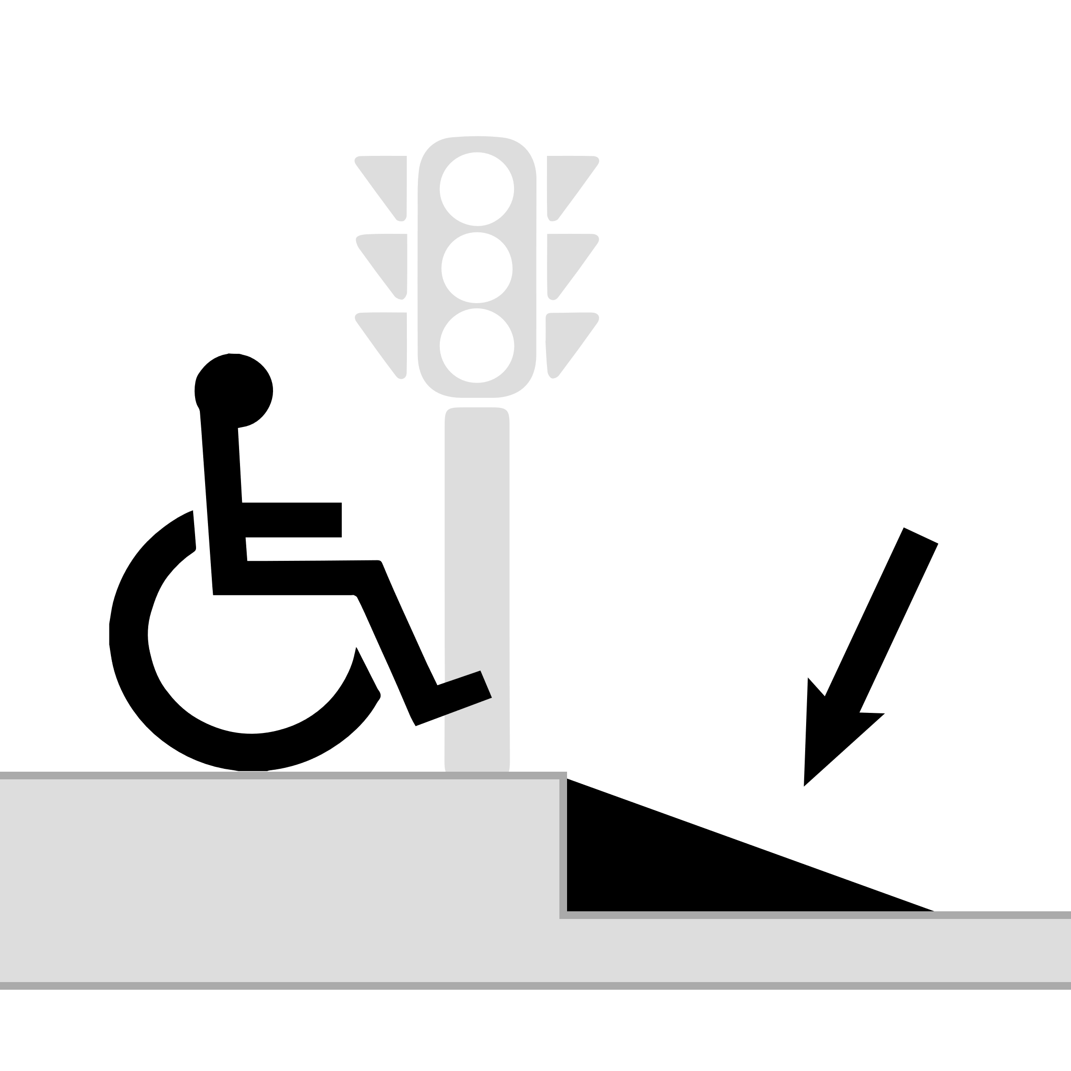
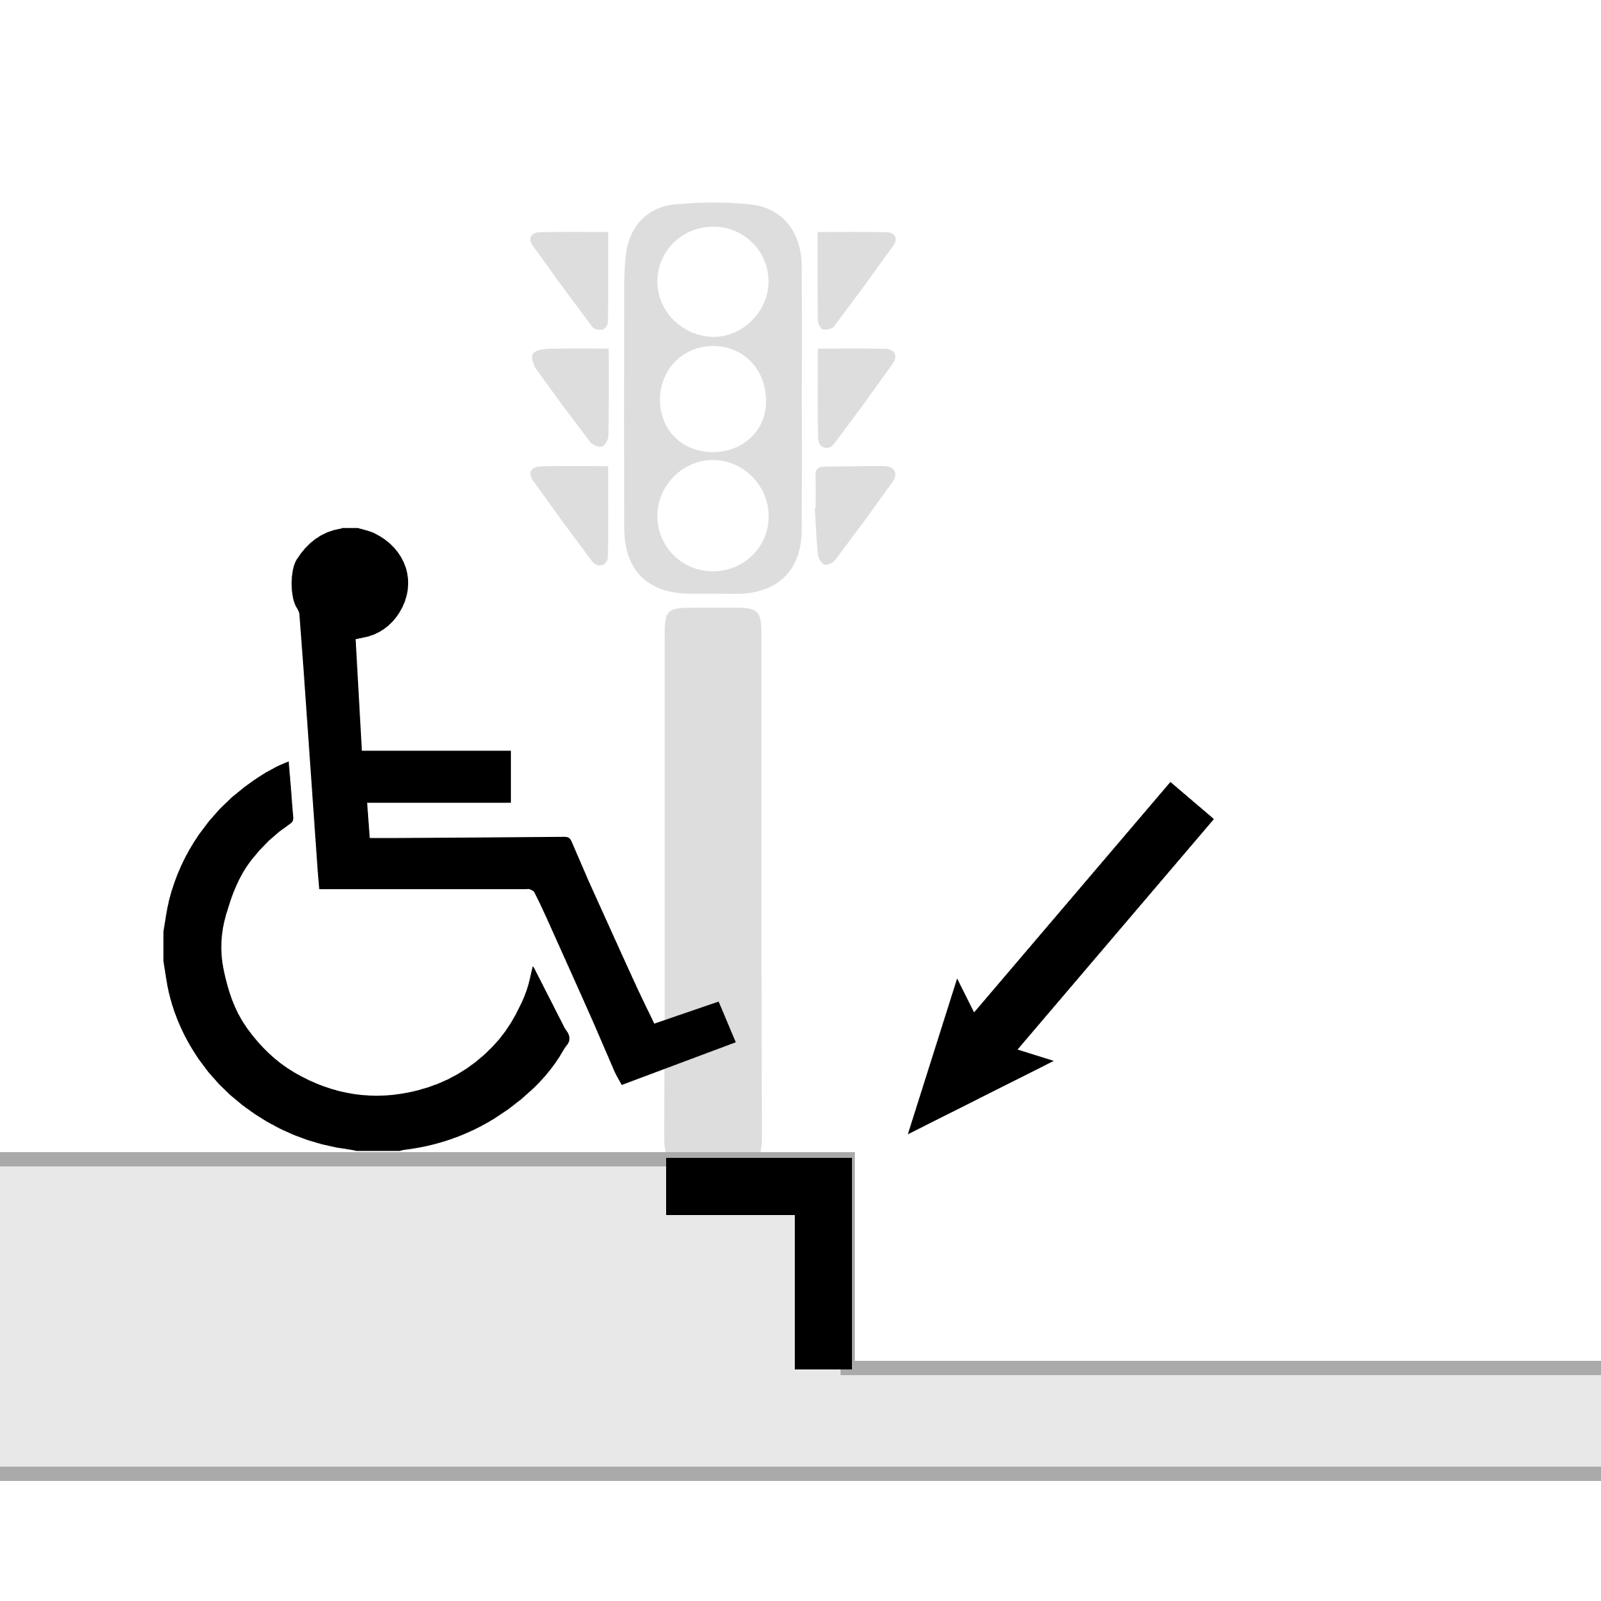
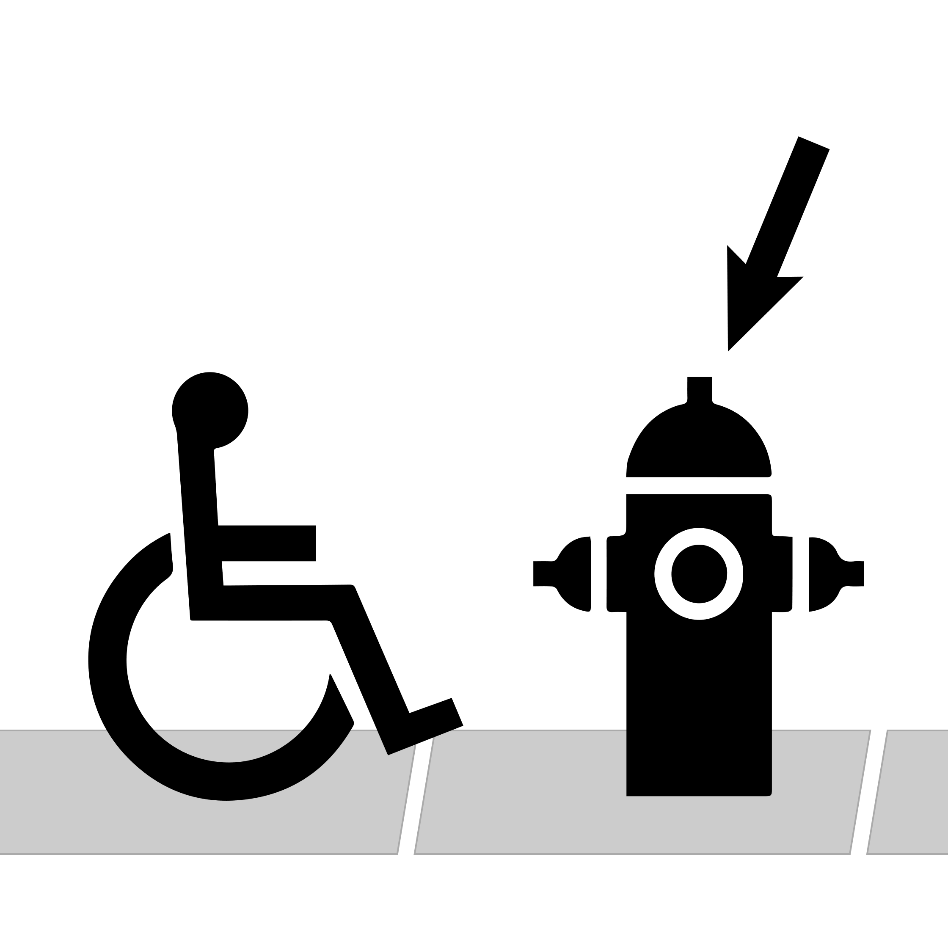
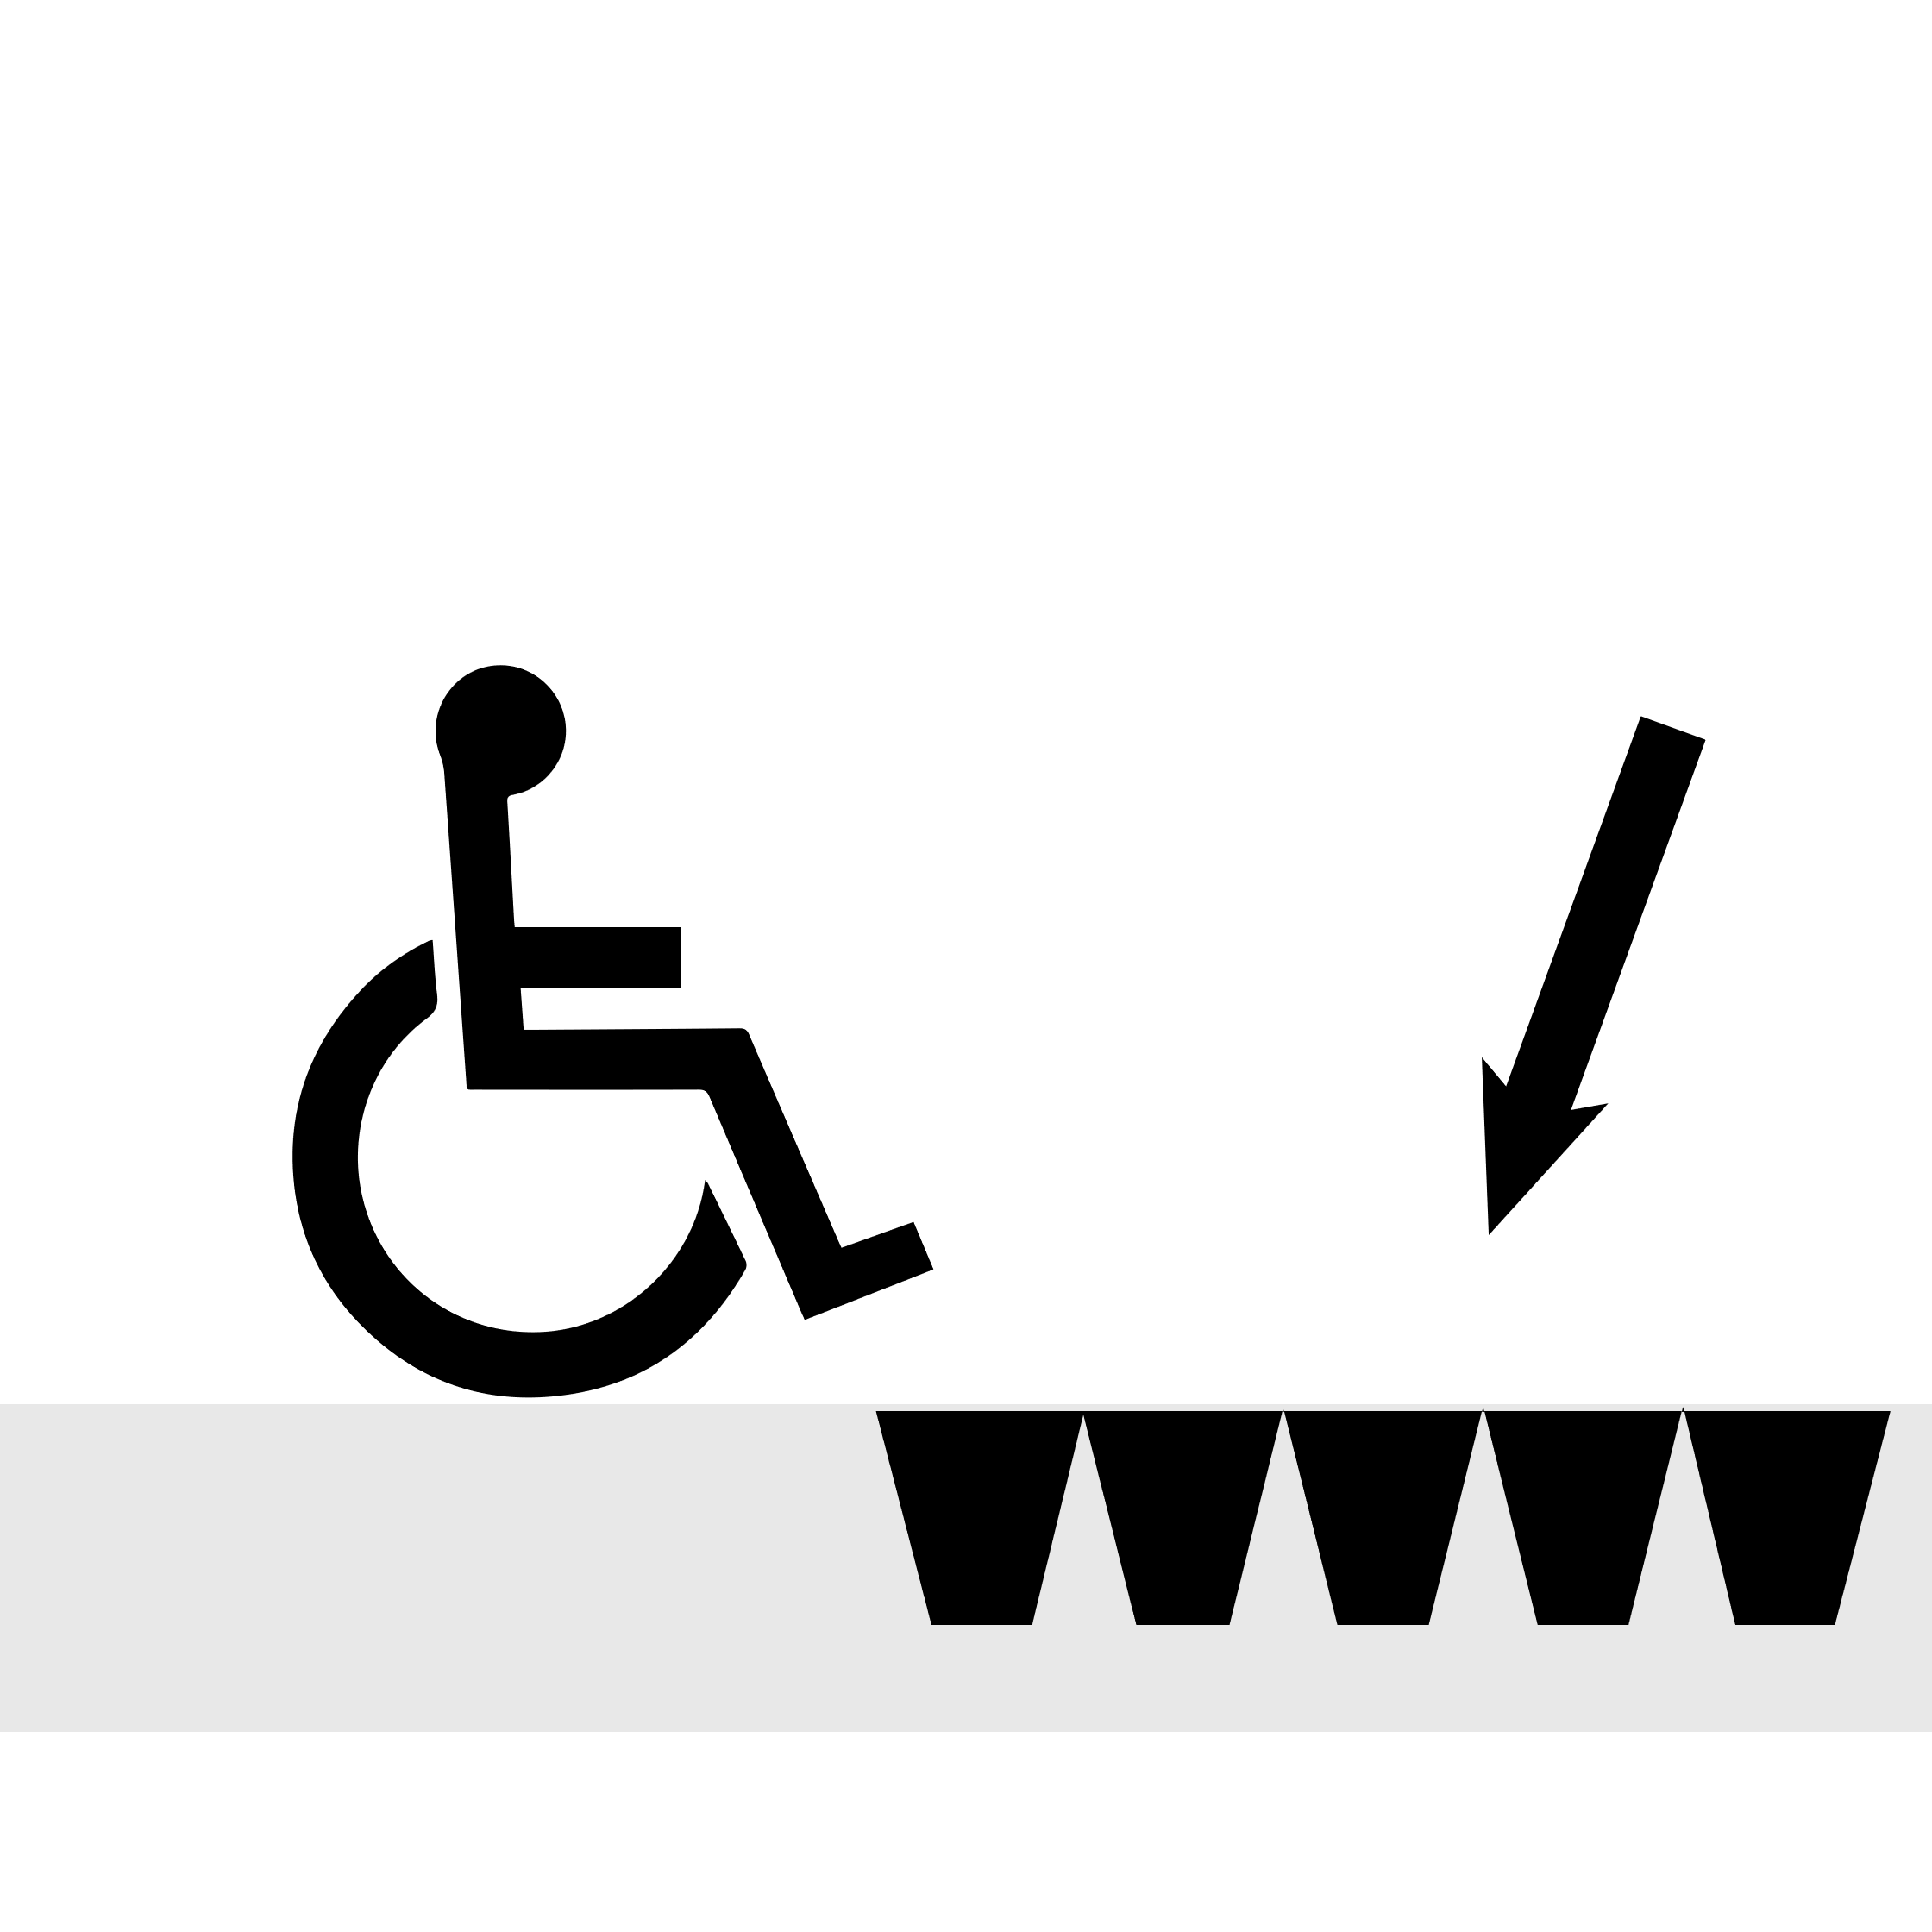

 | Count | Rank
Overall | 1,123 | 8th
Neighborhood | 223 | 4th
Inspect 1,000 ft in San Pedro, MX
50%
Missions
Missions
Distance
Labels
Accuracy
Validations
 | Missions
 | Count | Rank
Overall | 1,123 | 8th
Area | 223 | 4th
12
0.8 mi
1,123
83%
102
Missions
Overall: 12
 | Count | Rank
Overall | 12 | 6+
Area | 223 | 4th
9%
Labels
5th
 | Count | Rank
Overall | 1,123 | 8th
Area | 223 | 4th
3%
Distance
 | Count | Rank
Overall | 0.8 mi | 5th
Area | 0.2 mi | 4th
73%
Neighborhood: 6
Curb Ramps
Missing Ramps
Sidewalk Obstacle
Surface Problem
Missing Sidewalk
5th
15
22
33
44
66

Slide 45
 | Count | Rank
Overall | 1,123 | 8th
Neighborhood | 223 | 4th
Inspect 1,000 ft in San Pedro, MX
50%
Missions
Missions
Distance
Labels
Accuracy
Validations
 | Missions
 | Count | Rank
Overall | 1,123 | 8th
Area | 223 | 4th
12
0.8 mi
1,123
83%
102
Missions
9%
Overall: 12
 | Count | Rank
Overall | 12 | 6+
Area | 223 | 4th
Labels
5th
3%
 | Count | Rank
Overall | 1,123 | 8th
Area | 223 | 4th
Distance
 | Count | Rank
Overall | 0.8 mi | 5th
Area | 0.2 mi | 4th
73%
Neighborhood: 6
Curb Ramps
Missing Ramps
Sidewalk Obstacle
Surface Problem
Missing Sidewalk
5th
15
22
33
44
66

Slide 46
 | Count | Rank
Overall | 1,123 | 8th
Neighborhood | 223 | 4th
Inspect 1,000 ft in San Pedro, MX
50%
Missions
Missions
Distance
Labels
Accuracy
Validations
 | Missions
 | Count | Rank
Overall | 1,123 | 8th
Area | 223 | 4th
12
0.8 mi
1,123
83%
102
Curb Ramps
Missing Ramps
Sidewalk Obstacle
Surface Problem
Missing Sidewalk
Overall: 12
15
22
33
44
66
Missions
5th
 | Count | Rank
Overall | 12 | 6+
Area | 223 | 4th
9%
Labels
Neighborhood: 6
 | Count | Rank
Overall | 1,123 | 8th
Area | 223 | 4th
3%
Distance
5th
 | Count | Rank
Overall | 0.8 mi | 5th
Area | 0.2 mi | 4th
73%

Slide 47
 | Count | Rank
Overall | 1,123 | 8th
Neighborhood | 223 | 4th
Inspect 1,000 ft in San Pedro, MX
50%
Missions
Missions
Distance
Labels
Accuracy
Validations
 | Missions
 | Count | Rank
Overall | 1,123 | 8th
Area | 223 | 4th
12
0.8 mi
1,123
83%
102
Curb Ramps
Missing Ramps
Sidewalk Obstacle
Surface Problem
Missing Sidewalk
Overall: 12
15
22
33
44
66
Missions
5th
 | Count | Rank
Overall | 12 | 6+
Area | 223 | 4th
9%
Labels
Neighborhood: 6
 | Count | Rank
Overall | 1,123 | 8th
Area | 223 | 4th
3%
Distance
5th
 | Count | Rank
Overall | 0.8 mi | 5th
Area | 0.2 mi | 4th
73%

Slide 48
 | Count | Rank
Overall | 1,123 | 8th
Neighborhood | 223 | 4th
Inspect 1,000 ft in Dell Valle, MX
50%
Missions
Missions
Distance
Labels
Accuracy
Validations
 | Missions
 | Count | Rank
Overall | 1,123 | 8th
Area | 223 | 4th
12
0.8 mi
1,123
83%
102
Curb Ramps
Missing Ramps
Sidewalk Obstacle
Surface Problem
Missing Sidewalk
Overall: 12
15
22
33
44
66
Missions: 12 overall | 6 in Dell Valle
5th
 | Count | Rank
Overall | 12 | 6+
Area | 6 | 4th
9%
Labels: 1,123 overall | 223 in Dell Valle
Neighborhood: 6
 | Count | Rank
Overall | 1,123 | 8th
Area | 223 | 4th
3%
Distance: 0.8 overall | 0.1 in Dell Valle
5th
 | Count | Rank
Overall | 0.8 mi | 5th
Area | 0.2 mi | 4th
73%

Slide 49
 | Count | Rank
Overall | 1,123 | 8th
Neighborhood | 223 | 4th
Inspect 1,000 ft in San Pedro, MX
50%
Missions
Missions
Distance
Labels
Accuracy
Validations
 | Missions
 | Count | Rank
Overall | 1,123 | 8th
Area | 223 | 4th
12
0.8 mi
1,123
83%
102
Curb Ramps
Missing Ramps
Sidewalk Obstacle
Surface Problem
Missing Sidewalk
Overall: 12
15
22
33
44
66
5th
Missions
Overall | 12 | 6+
Area | 223 | 4th
9%
Labels
Neighborhood: 6
 | Count | Rank
Overall | 1,123 | 8th
Area | 223 | 4th
3%
Distance
5th
 | Count | Rank
Overall | 0.8 mi | 5th
Area | 0.2 mi | 4th
73%

Slide 50
Inspect 1,000 ft in San Pedro, MX
50%
Missions
Overall: 12
Neighborhood: 6
9%
5th
4th
Overall: 12
Neighborhood: 6

Slide 51
Inspect 1,000 ft in Dell Valle, MX
50%
Your Overall Stats
Missions
Distance
Labels
Accuracy
Validations
12
0.8 mi
1,123
83%
102
Achievements
Overall: 12
Neighborhood: 6
Missions: 12
20%
Overall
Del Valle
8 more missions until next badge!
5th
3rd
Overall
Del Valle
Labels: 1,123
3%
 | Count | Rank
Overall | 1,123 | 8th
Area | 223 | 4th
430 more labels until next badge!
5th
3rd
Overall
Del Valle
Distance: 0.8 mi
73%
0.2 more miles until next badge!
5th
3rd
 | Count | Rank
Overall | 0.8 mi | 5th
Area | 0.2 mi | 4th

Slide 52
Inspect 1,000 ft in Dell Valle, MX
50%
Your Overall Stats
Missions
Distance
Labels
Accuracy
Validations
12
0.8 mi
1,123
83%
102
Achievements
Overall: 12
Neighborhood: 6
Missions: 12
20%
Labels: 1,123
3%
Distance: 0.8 mi
73%
 | Count | Rank
Overall | 1,123 | 8th
Area | 223 | 4th
 | Count | Rank
Overall | 0.8 mi | 5th
Area | 0.2 mi | 4th

Slide 53
Inspect 1,000 ft in Dell Valle, MX
50%
Your Overall Stats
Missions
Distance
Labels
Accuracy
Validations
12
0.8 mi
1,123
83%
102
Achievements
Overall: 12
Neighborhood: 6
Missions: 12
Overall Dell Valle
8 more missions until next badge!
 | Del Valle | Overall
Missions | 4 | 12
Labels | 330 | 1,123
Distance | 0.1 | 0.8
Labels: 1,123
20%
3%
8 more missions until next badge!
Distance: 0.8 mi
73%
8 more missions until next badge!
 | Count | Rank
Overall | 0.8 mi | 5th
Area | 0.2 mi | 4th

Slide 54
Inspect 1,000 ft in Dell Valle, MX
Maybe we save the neighborhood dependent stats for the modal mission screens?
50%
Your Stats
Missions
Distance
Labels
Accuracy
Validations
Overall:
Del Valle:
12
0.8 mi
1,123
83%
102
5
0.1 mi
98
93%
N/A
Overall: 12
Neighborhood: 6
Achievements
Missions: 12
20%
Overall
Del Valle
8 more missions until next badge!
5th
3rd
 | Count | Rank
Overall | 1,123 | 8th
Area | 223 | 4th
Overall
Del Valle
Labels: 1,123
3%
5th
3rd
Overall
Del Valle
Distance: 0.8 mi
73%
5th
3rd
 | Count | Rank
Overall | 0.8 mi | 5th
Area | 0.2 mi | 4th

Slide 55
 | Count | Rank
Overall | 1,123 | 8th
Neighborhood | 223 | 4th
Missions
 | Missions
 | Count | Rank
Overall | 1,123 | 8th
Area | 223 | 4th
Overall: 12
5th
Neighborhood: 6
5th

Slide 56






